Slide 1


Surveillance
Self-defense
Information in the presentation is sourced from the Electronic Frontier Foundation under a Creative Commons License.
https://ssd.eff.org
By Mike
@QuantumCheap
And now...
@quantumcheap@infosec.exchange

Slide 2
TABLE OF CONTENTS
01
03
02
04
YOUR SECURITY PLAN
CHOOSING YOUR TOOLS
5 Questions
Self Explanitory
EXERCISE
LINKS N’ STUFF
Build security plans for three scenarios
Websites on the Information Superhighway

Slide 3
YOUR SECURITY PLAN
01

Slide 4
KEY DEFINITIONS
DATA
THREAT
Any kind of information, typically stored in a digital form.
A potential event that could undermine your efforts to defend your data
META-DATA
THREAT MODEL
data that describes a piece of information
A way of thinking about the sorts of protection you want for your data so you can decide which potential threats you are going to take seriously.
Notes:
Data - Any kind of information, typically stored in a digital form.
Data can include documents, pictures, keys, programs, messages, and other digital information or files.
Metadata (or \"data about data\") is data that describes a piece of information
Threat - A potential event that could undermine your efforts to defend your data.
Threats can be intentional (conceived by attackers), or they could be accidental (you might leave your computer turned on and unguarded).
Threat model - A way of thinking about the sorts of protection you want for your data so you can decide which potential threats you are going to take seriously.
It's impossible to protect against every kind of trick or adversary, so you should concentrate on which people might want your data, what they might want from it, and how they might get it. Coming up with a set of possible threats you plan to protect against is called threat modeling or assessing your risks.

Slide 5
5 QUESTIONS
1. What do I want to protect?
2. Who do I want to protect it from?
3. How bad are the consequences if I fail?
4. How likely is it that I will need to protect it?
5. How much trouble am I willing to go through to prevent these consequences?

Slide 6
5 QUESTIONS – HOME EXAMPLE
1. What do I have inside my home that is worth protecting?
  Assets could include: jewelry, electronics, financial documents, passports, or photos
2. Who do I want to protect it from?
  Adversaries could include: burglars, roommates, or guests
3. How bad are the consequences if I fail?
  Do I have anything in my house that I cannot replace? Do I have the time or money to replace these things? Do I have insurance that covers goods stolen from my home?
4. How likely is it that I will need to protect it?
  Does my neighborhood have a history of burglaries? How trustworthy are my roommates/guests? What are the capabilities of my adversaries? What are the risks I should consider?
5. How much trouble am I willing to go through to prevent these consequences?
  Am I willing to buy a safe for sensitive documents? Can I afford to buy a high-quality lock? Do I have time to open a security box at my local bank and keep my valuables there?

Slide 7
01
What do I want to protect?
An “asset” is something you value and want to protect. In the context of digital security, an asset is usually some kind of information. For example, your emails, contact lists, instant messages, location, and files are all possible assets. Your devices may also be assets.
Make a list of your assets: data that you keep, where it’s kept, who has access to it, and what stops others from accessing it.

Slide 8
02
Who do I want to protect it from?
To answer this question, it’s important to identify who might want to target you or your information. A person or entity that poses a threat to your assets is an “adversary.” Examples of potential adversaries are your boss, your former partner, your business competition, your government, or a hacker on a public network.
Make a list of your adversaries, or those who might want to get a hold of your assets. Your list may include individuals, a government agency, or corporations.
Notes:
Note: Depending on who your adversaries are, under some circumstances this list might be something you want to destroy after you’re done security planning.

Slide 9
03
How bad are the consequences if I fail?
Security planning involves understanding how bad the consequences could be if an adversary successfully gains access to one of your assets. To determine this, you should consider the capability of your adversary. For example, your mobile phone provider has access to all your phone records. A hacker on an open Wi-Fi network can access your unencrypted communications. Your government might have stronger capabilities.
Write down what your adversary might want to do with your private data.
Notes:
Note: Depending on who your adversaries are, under some circumstances this list might be something you want to destroy after you’re done security planning.

Slide 10
04
How likely is it that I will need to protect it?
Assessing risks is both a personal and a subjective process. Many people find certain threats unacceptable no matter the likelihood they will occur because the mere presence of the threat at any likelihood is not worth the cost. In other cases, people disregard high risks because they don’t view the threat as a problem.
Write down which threats you are going to take seriously, and which may be too rare or too harmless (or too difficult to combat) to worry about.
Notes:
Note: Depending on who your adversaries are, under some circumstances this list might be something you want to destroy after you’re done security planning.

Slide 11
05
How much trouble am I willing to go through to try to prevent potential consequences?
There is no perfect option for security. Not everyone has the same priorities, concerns, or access to resources. Your risk assessment will allow you to plan the right strategy for you, balancing convenience, cost, and privacy.
For example, an attorney representing a client in a national security case may be willing to go to greater lengths to protect communications about that case, such as using encrypted email, than a family member who regularly emails funny cat videos.
Write down what options you have available to you to help mitigate your unique threats. Note if you have any financial constraints, technical constraints, or social constraints.
Notes:
Note: Depending on who your adversaries are, under some circumstances this list might be something you want to destroy after you’re done security planning.

Slide 12
EXERCISE
02
Break into three groups. You may do the activity individually as well.

Slide 13
GROUP ACTIVITY – SCENARIOS
Scenario 1
- You are a regular college student, doing collegey things
Scenario 2
- You are an activist or a journalist documenting a protest
Scenario 3
- You are a man seeking hair transplant. Men’s hair transplants are now illegal in TX. Anyone who helps you get a hair transplant or helps you go out-of-state for a hair transplant can sue you for $10,000. It’s also a felony to get Rogaine sent to you by mail.

Slide 14
5 QUESTIONS
1. What do I want to protect?
2. Who do I want to protect it from?
3. How bad are the consequences if I fail?
4. How likely is it that I will need to protect it?
5. How much trouble am I willing to go through to prevent these consequences?

Slide 15
SCENARIO 1 - STUDENT
Avoid using school resources for personal communications
Use encryption on your devices.
Use a password manager to create strong passwords.
Change your privacy settings on social networks
Use E2E encrypted messaging apps
Share data privacy tool and knowledge with others
https://ssd.eff.org/module/privacy-students

Slide 16
SCENARIO 2 – ACTIVIST/JOURNALIST
Use encryption on your devices
Disable biometric authentication
Use a Virtual Private Network (VPN)
Use TOR/TailsOS
Take photos and videos without unlocking your device
Scrub metadata on photos anchor link
Use a disposable burner phone
Dress for anonymity and safety
https://ssd.eff.org/module/attending-protest

Slide 17
SCENARIO 3 – HAIR TRANSPLANT SEEKER
Keep the data about this separate from your daily activities
Review privacy policies of “hair growth tracker” apps
Clear all cached data
Use E2E encrypted messaging apps
Use a burner phone
Turn off all location tracking
https://bit.ly/3z8O2v8
https://bit.ly/40v5sgW

Slide 18
CHOOSING YOUR TOOLS
03

Slide 19
CHOOSING YOUR TOOLS
Security is a Process, not a Purchase
Ask…
How Transparent is it?
How Clear are its Creators About its Advantages and Disadvantages?
What Happens if the Creators are Compromised?
Has it Been Recalled or Criticized Online?
Which Phone Should I Buy? Which Computer?
Notes:
Security is a Process, not a Purchase
The first thing to remember before changing the software you use or buying new tools is that no tool or piece of software will give you absolute protection from surveillance in all circumstances. Therefore, it’s important to think about your digital security practices holistically. For example, if you use secure tools on your phone, but don’t put a password on your computer, the tools on your phone might not help you much. If someone wants to find out information about you, they will choose the easiest way to obtain that information, not the hardest.
How Transparent is it?
There's a strong belief among security researchers that openness and transparency leads to more secure tools.
Open-source software provides the opportunity for better security, but does not guarantee it. The open source advantage relies, in part, on a community of technologists actually checking the code, which, for small projects (and even for popular, complex ones), may be hard to achieve.
How Clear are its Creators About its Advantages and Disadvantages?
No software or hardware is entirely secure. Seek out tools with creators or sellers who are honest about the limitations of their product.
Blanket statements that say that the code is “military-grade” or “NSA-proof” are red flags. These statements indicate that the creators are overconfident or unwilling to consider the possible failings in their product.
What Happens if the Creators are Compromised?
But there's one attacker that many manufacturers do not want to think about: themselves! What if they are compromised or decide to attack their own users? For instance, a court or government may compel a company to hand over personal data or create a “backdoor” that will remove all the protections their tool offers.
Has it Been Recalled or Criticized Online?
Companies selling products and enthusiasts advertising their latest software can be misled, be misleading, or even outright lie. A product that was originally secure might have terrible flaws in the future. Make sure you stay well-informed on the latest news about the tools that you use.
Which Phone Should I Buy? Which Computer?
Some general advice is almost always true, however. When you buy a device or an operating system, keep it up-to-date with software updates.

Slide 20
04
LINKS N’ STUFF

Slide 21
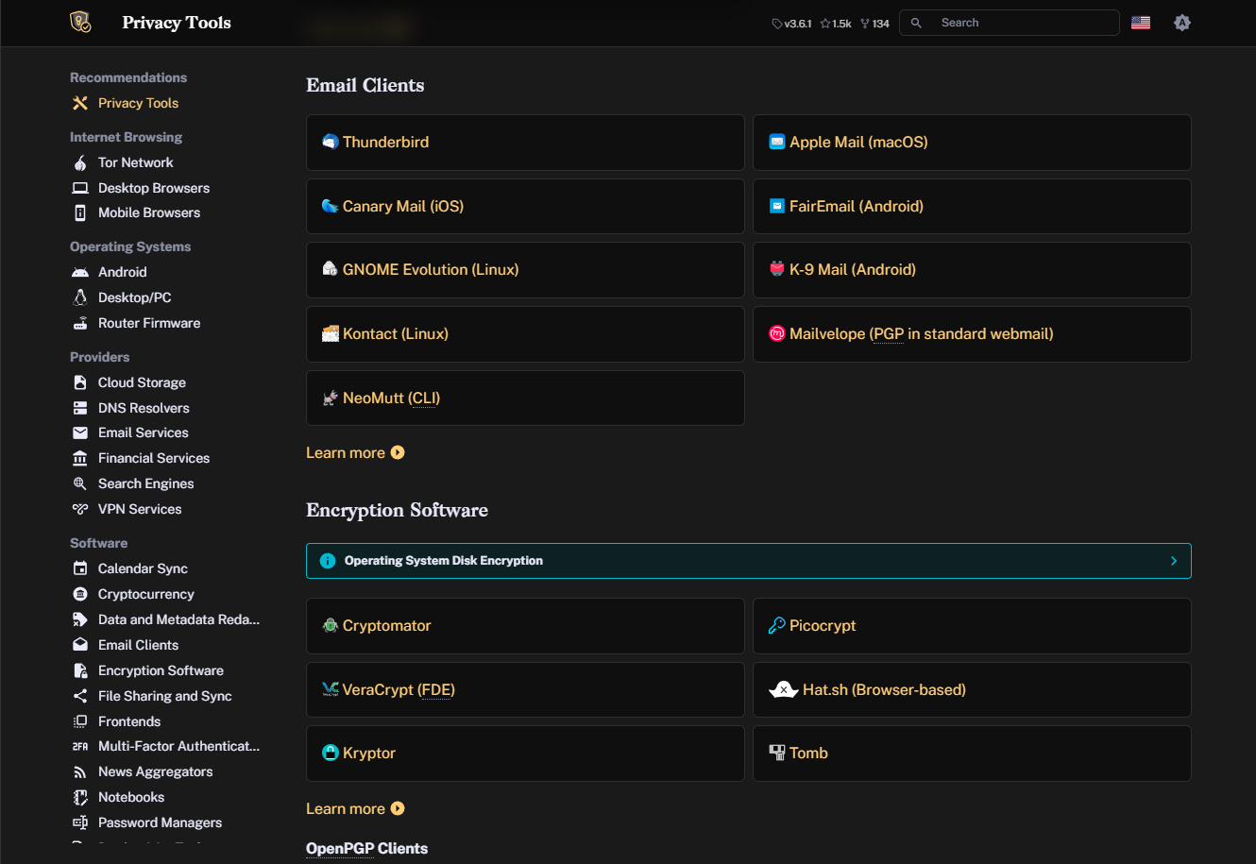
privacyguides.org
Privacy Guides
Comprehensive list of common and vetted tools to boost your privacy.
(formerly privacytools.org)

Slide 22
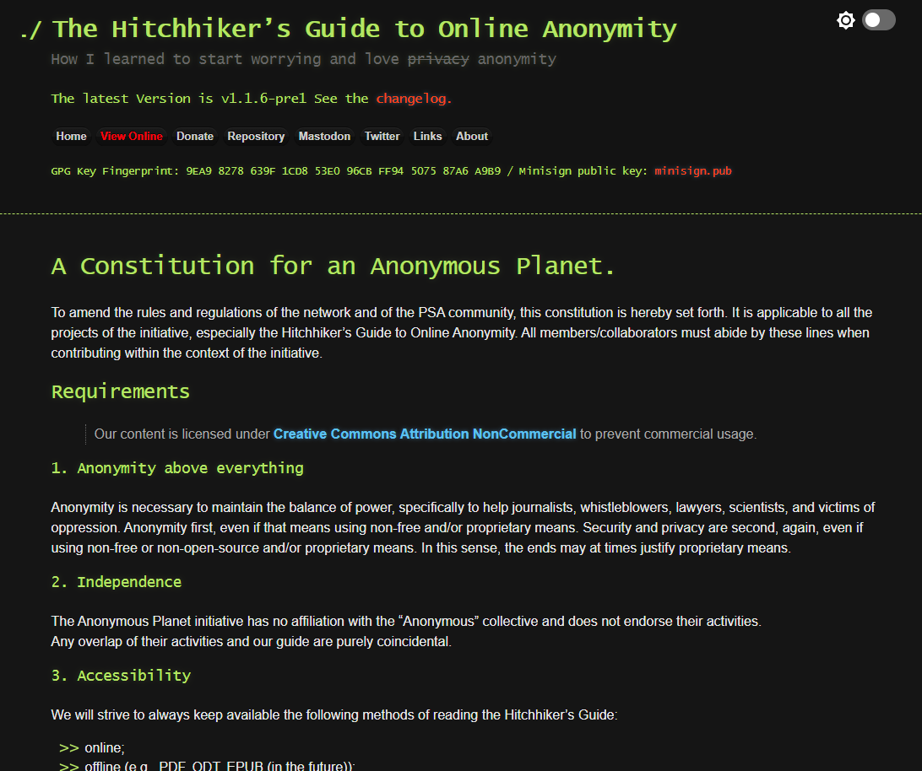
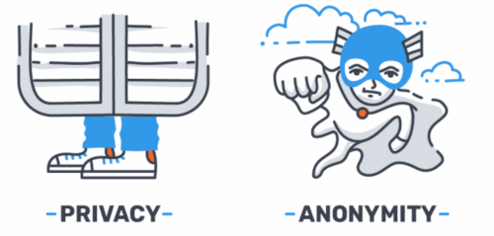
anonymousplanet.org
The Hitchhiker’s Guide to Online Anonymity
Super deep dive into anonymity.
Privacy is about people knowing who you are but not knowing what you are doing.
Anonymity is about people knowing what you are doing but not knowing who you are.

Slide 23
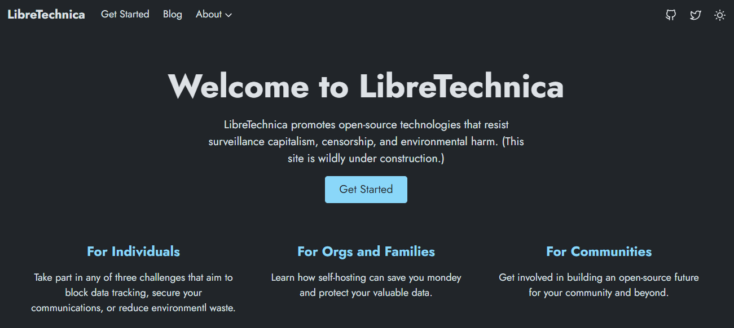
libretechnica.org
More links and resources can be found at LibreTechnica!
Click on “For Individuals” > “Privacy Challenge”
https://libretechnica.github.io/docs/individuals/privacy_challenge/

Slide 24
THANKS!
Do you have any questions?
@QuantumCheap @quantumcheap@infosec.exchange
Please keep this slide for attribution

